Slide 1
DIGITAL PORTFOLIO
STUDENT NAME : LAKSHMANAN R
REGISTER NO : 212402799
NMID : 7E60D58CDF9F47AABEA4CC1EEF8B18D6
DEPARTMENT : BCA
COLLEGE : SRM ARTS AND SCIENCE COLLEGE CHENGALPATTU/MADRAS UNIVERSITY

Slide 2
PROJECT TITLE
Digital Portfolio Website for Academic and Career Growth

Slide 3

AGENDA
Problem Statement
Project Overview
End Users
Tools and Technologies
Portfolio design and Layout
Features and Functionality
Results and Screenshots
Conclusion
Github Link
3/21/2024 Annual Review

Slide 4

PROBLEM STATEMENT
In today’s digital era, a professional online presence is essential for IT students and beginners.
Traditional resumes are static and cannot showcase projects, creativity, or technical skills interactively.
Without a portfolio, recruiters and peers find it difficult to evaluate practical abilities.
A portfolio website can serve as a digital resume, highlighting skills and achievements.

Slide 5

PROJECT OVERVIEW
Development of a personal portfolio website to represent me professionally.
Website includes sections: About Me, Skills, Education, Projects, Resume, and Contact Information.
Acts as a centralized platform for showcasing academic background, skills, hobbies, and achievements.
Designed to be user-friendly, responsive, and mobile-compatible.

Slide 6

WHO ARE THE END USERS?
Recruiters, employers, and HR professionals who evaluate skills and projects.
Teachers and mentors to monitor progress and academic achievements.
Peers and collaborators interested in working on projects together.
Students and beginners who want inspiration for creating their own portfolios.

Slide 7

TOOLS AND TECHNIQUES
HTML → Provides the structure of the website.
CSS → Ensures styling, layout, and professional design.
JavaScript → Adds interactivity and dynamic features.
Bootstrap → Improves responsiveness and offers ready-made components.
Together, these tools create a functional, responsive, and visually appealing website.

Slide 8
PORTFOLIO DESIGN AND LAYOUT
Follows a clean and modern layout.
Homepage introduces me with a short description.
Sections include About Me, Skills, Projects, Resume Download option.
Navigation bar for quick and easy access.
Minimal design, professional look, and focused on user experience.
8

Slide 9
FEATURES AND FUNCTIONALITY
Responsive design → Works on desktops, tablets, and mobiles.
Sections for academic details, technical skills, hobbies, and achievements.
Option to download resume directly from the site.
Projects are showcased with brief descriptions and technologies used.
Contact section → Allows communication via email and social media links.
Creates an interactive and professional digital profile.

Slide 10

RESULTS AND SCREENSHOTS
Fully functional personal portfolio website developed successfully.
Highlights academic journey, skills, and technical abilities effectively.
Includes screenshots of homepage, About Me, Skills, Projects, and Contact sections.
Final result: A professional digital resume that increases career visibility.
3/21/2024 Annual Review
10

Slide 11
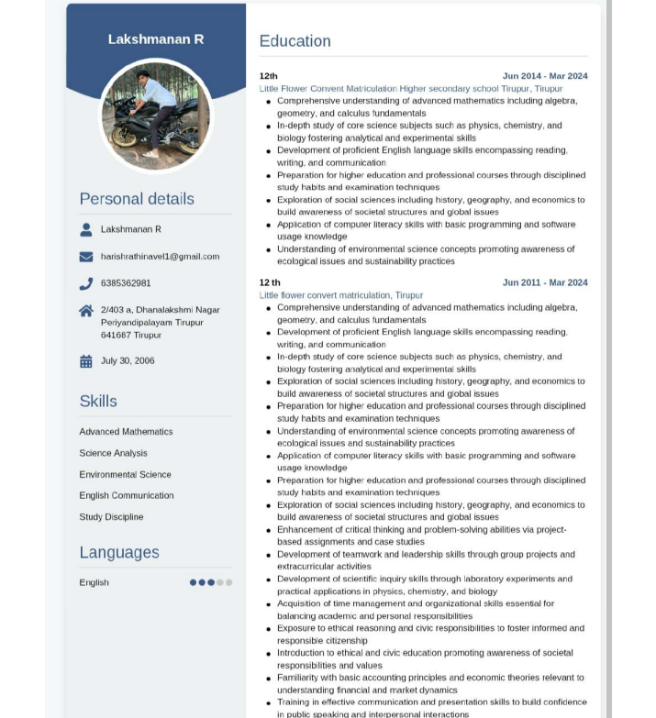
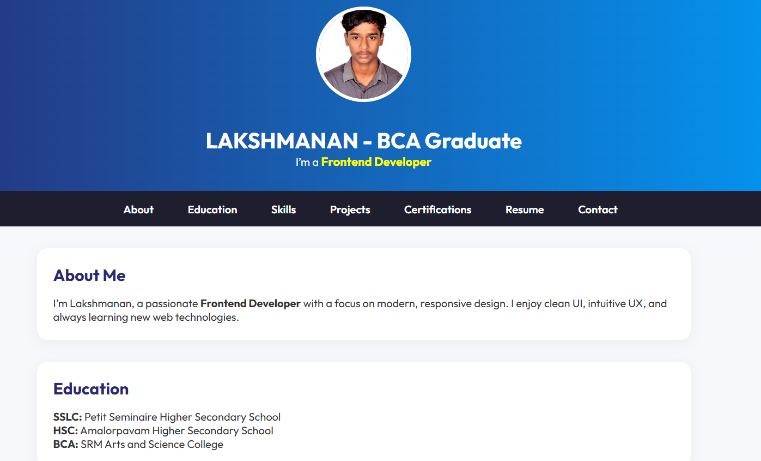
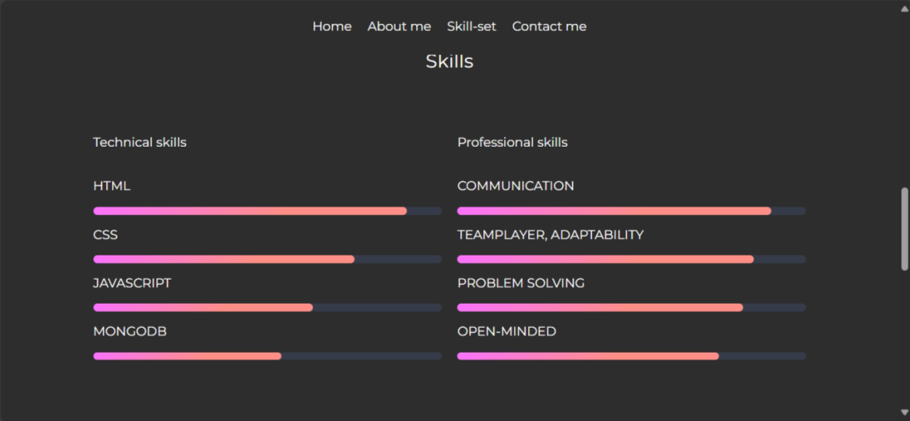

Slide 12
CONCLUSION
Project provided hands-on experience in web design and development.
Improved knowledge of HTML, CSS, JavaScript, and Bootstrap.
Enhanced creativity and problem-solving skills.
Portfolio acts as a strong digital identity for academic and career growth.
Future scope: Add features like blog section, project links, and interactive elements.
12

Slide 13
GITHUB LINK
CLICK HERE : https://lakshmananr07.github.io/nm/

